Slide 1
Plagiarism detection using string matching
Antra Aruj
Akshi Sharma
CSC 575: Algorithms
Notes:
‹#›

Slide 2
Outline
String matching problem
Definition of the Rabin-Karp algorithm
How Rabin-Karp works
Definition of LCS algorithm
How LCS works
Complexity
Notes:
‹#›
I am not including the mathematical ideas in my presentation. However, I will refer to ideas such as Horner’s Rule for the final presentation to be turned in.

Slide 3
String Matching Problem
The idea of the string matching problem is that we want to find all occurrences of the pattern P in the given text T.
We could use the brute force method for string matching, which utilizes iteration over T. At each letter, we compare the sequence against P until all letters match of until the end of the alphabet is reached.
The worst case scenario can reach O(N*M)
Notes:
‹#›
For example, we are given the string T=ababbbabbababbbbbaaababa and the pattern P=aba. In the brute force method, we would compare T and P at each letter. For example:
1 2 3 4 5 6 7 8 9 10 11 12 13 14 15 16 17 18 19 20 21 22 23 24
a b a b b b a b b a b a b b b b b a a a b a b a
a b a
You would compare the letters at [1]. If they were equal, then you would compare the letters at [2]. You repeat the procedure. If the letters aren’t equal, then you shift the pattern to the next letter and compare.
Why would you want to do this? You would have to go back and recheck letters that you have already compared.

Slide 4
Definition of Rabin-Karp
A string search algorithm which compares a string's hash values, rather than the strings themselves. For efficiency, the hash value of the next position in the text is easily computed from the hash value of the current position.
Notes:
‹#›

Slide 5
How Rabin-Karp works
The Rabin-Karp string searching algorithm calculates a hash value for the pattern, and for each M-character subsequence of text to be compared. M is the length of Pattern.
If the hash code value matched the algorithm will do comparison between pattern and string to be compared.
Notes:
‹#›
To compute p, we use Horner’s rule
p = P[m] + 10(P[m-1] + 10(P[m-2] + … + 10(P[2] + 10(P[1]) …))
in which we can compute in time O(m).

Slide 6
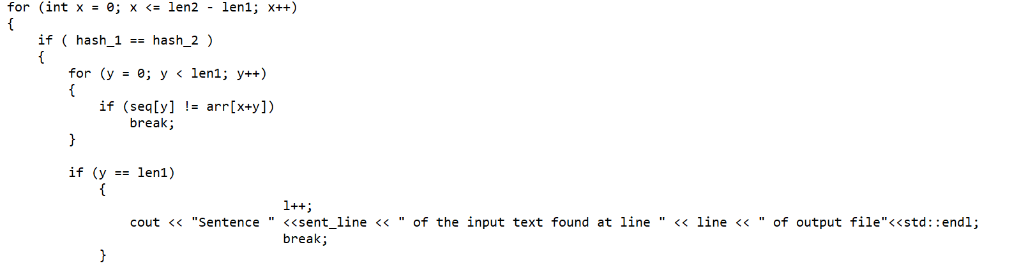
How Rabin-Karp works (continued)
IF the Hash code value is not matched, the algorithm will compute hash code value of string to be compared for next M character.
Notes:
‹#›
Concept 3 will be further explained in the example of the Rabin-Karp algorithm at work

Slide 7
Approach Specific to the Problem
I have taken String s and a input file and I have taken pattern as each sentence separated by delimiter full stop in String s.
Then for each sentence I checked if the sentence is matched with any of the lines of input files.
At last I have kept two counter -> m for total sentence in the string s and n for total matched sentence of string s and I have kept plagiarism count to 70 percent and checked if significant plagiarism is detected or not.

Slide 8
LCS Implementation Approach
Implemented the LCS algorithm to identify percentage of commonality between given test file and stored files.
Implemented the algorithm in C programming language.
Steps involved in implementation :
Loading of source and test data
Initialization of the 2D matrix
Calculation of matrix element using LCS algorithm
Traverse backward from last element of the matrix and print out the LCS

Slide 9
Definition of longest common subsequence (LCS)
The LCS problem is the problem of finding the longest subsequence common to all sequences in a set of sequences.
It differs from the longest common substring problem, unlike substrings, subsequences are not required to occupy consecutive positions within the original sequences.

Slide 10
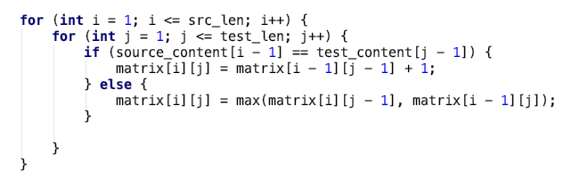
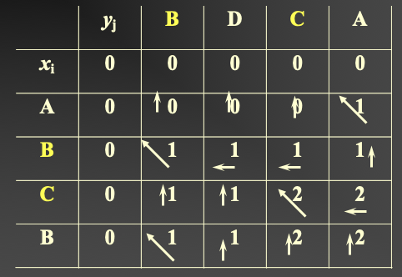
Implementation of LCS

Slide 11
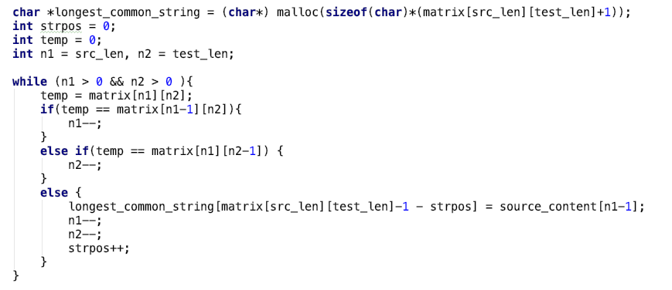
Retrieval of LCS

Slide 12
Results
Given String :
The longest common subsequence (LCS) problem is the problem of finding the longest subsequence common to all sequences in a set of sequences (often just two sequences). It differs from the longest common substring problem: unlike substrings, subsequences are not required to occupy consecutive positions within the original sequences. The longest common subsequence problem is a classic computer science problem, the basis of data comparison programs such as the diff utility, and has applications in computational linguistics and bioinformatics. It is also widely used by revision control systems such as Git for reconciling multiple changes made to a revision-controlled collection of files.”
Test String :
“The longest common subsequence (LCS) problem is the problem of finding the longest subsequence common to all sequences in a set of sequences (often just two sequences).”

Slide 13
Result Cont’d
Length of LCS Pattern : 109
LCS Found :
LCS problem is the problem of finding the longest subsequence common to all sequences e sequences oen ust t e
Percentage of LCS pattern match : 71.0 %
Final common words length: 96
Final common words ::
LCS problem is the problem of finding the longest subsequence common to all sequences sequences
Percentage of Plagiarism : 62.0 %
Execution time: 0.000544 seconds

Slide 14
Complexity
The running time of the Rabin-Karp algorithm in the worst-case scenario is O(n-m+1)m but it has a good average-case running time.
The running time of the LCS algorithm in the worst-case scenario is O(n*m) but it has a good average-case running time.
Notes:
‹#›

Slide 15
Thank you!

